Slide 1

Hocus Game Solver
Maheen Ahmed
(429551)
Taha Shah
(408351)
Zain Ali
(405704)

Slide 2
TABLE OF CONTENTS
02
03
04
05
01
Introduction & Problem Statement
Hocus
A brief introduction to the 6-dimensional puzzle game and terminology
Demonstration
Methodology
Demonstrating our game solver in action
What steps are performed by the Solver
Results

Slide 3
01
Problem Statement
Introduction & Problem Statement
Introduction
&

Slide 4
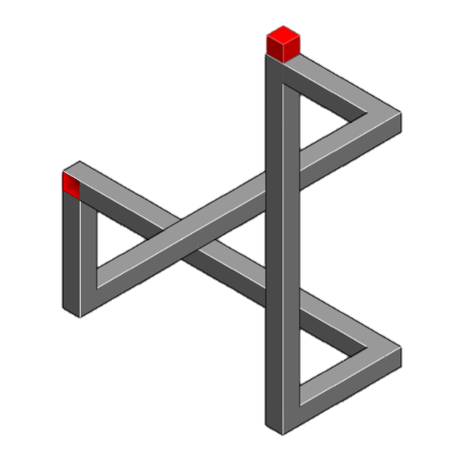
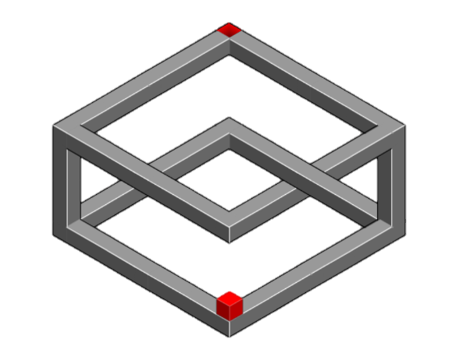
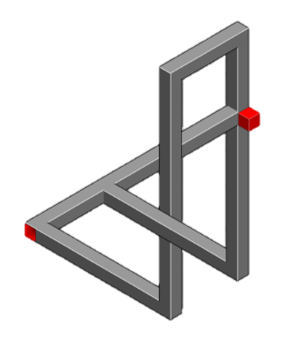
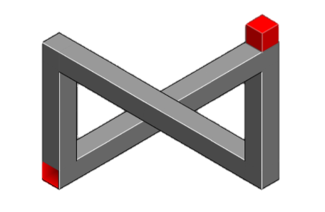
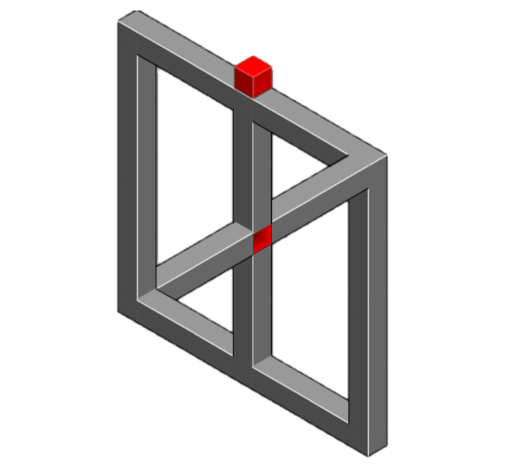
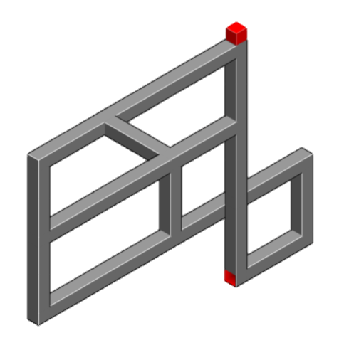
Introduction
We aim to create a Hocus Solver, which will detect some information about the system and attempt to explore and thus solve it.
Problem Statement
Most existing game-solving agents rely on the availability of source code, but many real-world scenarios, including games like Hocus, do not provide this access. This project focuses on solving puzzles without depending on source code by analyzing static images.
Extracting an underlying graph structure from 2D images of a 3D puzzle is non-trivial due to the multidimensional nature of the problem and limited data availability. This requires accurate identification of intersections and graph construction across six dimensions.
Solving the puzzle requires efficient traversal of the constructed graph using robust algorithms like BFS, DFS, and Dijkstra

Slide 5


02
Hocus

Slide 6
Hocus
GOAL: Get the box from the starting position to the destination

Slide 7
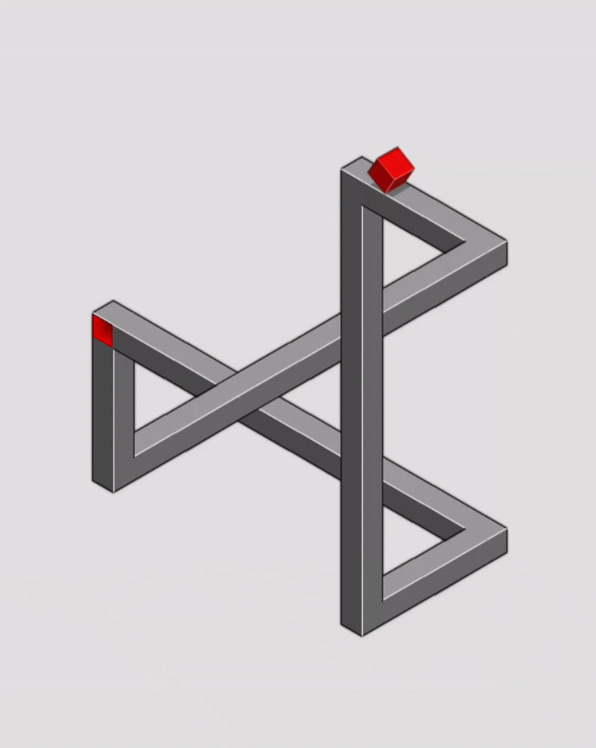
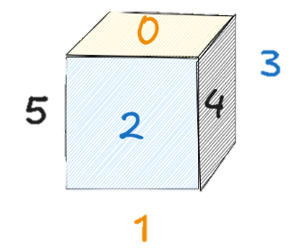
Gameplay
There exist 6 dimensions that our box might have to traverse through
GOAL: Get the box from the starting position to the destination
Each dimension represents the side of a rod/platform
They have been numbered from 0 to 5
Dimensions 0, 2, and 4 are the only ones visible to the naked eye

Slide 8
Hocus
Dim 0
There exist 6 dimensions that our box might have to traverse through
Overlap Case
Portal
Dim 2
Dim 4
Each dimension represents the side of a rod/platform
They have been numbered from 0 to 5
Dimensions 0, 2, and 4 are the only ones visible to the naked eye
Decision Node

Slide 9
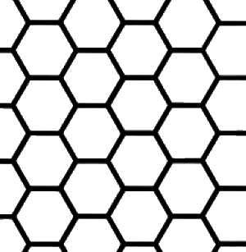
Hocus
There exist 6 dimensions that our box might have to traverse through
Overlap Case
Portal
All these types of cases can be mapped through nodes
A node is any decision point where a box can stop, change direction and/or dimension, or keep going forward
A node can be uniquely identified by its hexagon and a pair of dimension numbers
Decision
Maze can be split into hexagons
Hexagons are the building blocks of the maze
They help identify and isolate nodes
Each dimension represents the side of a rod/platform
They have been numbered from 0 to 5

Slide 10
Hocus
Overlap Case
Maze can be split into hexagons
Hexagons are the building blocks of the maze
They help identify and isolate nodes
Portal
All these types of cases can be mapped through nodes
A node is any decision point where a box can stop, change direction and/or dimension, or keep going forward
A node can be uniquely identified by its hexagon and a pair of dimension numbers
Decision Node

Slide 11
03
Demonstration

Slide 12
Demonstration
Connect mobile device to laptop
Pick any level or create your own maze
Once the level is ready, hit Space
The Solver automatically and immediately swipes and solves the game with the shortest path possible, lest it exists.

Slide 13
04
Methodology
The steps followed to achieving the demonstrations performed:
1. SCREENSHOT
5. SOLVING MAZE
2. PROCESSING SCREENSHOT
6. CONVERTING PATH TO SWIPES
3. MODELING MAZE INTO CODE
7. PERFORMING SWIPES
4. EXPLORING MAZE

Slide 14
Methodology
The steps followed to achieving the demonstrations performed:
1. SCREENSHOT
5. SOLVING MAZE
2. PROCESSING SCREENSHOT
6. CONVERTING PATH TO SWIPES
3. MODELING MAZE INTO CODE
7. PERFORMING SWIPES
4. EXPLORING MAZE
The mobile device is connected to the Solver through ADB (Android Debug Bridge)
ADB fetches the screenshot of the maze upon the pressing of the space bar on the laptop

Slide 15
The steps followed to achieving the demonstrations performed:
Methodology
Hocus
1. SCREENSHOT
2. PROCESSING SCREENSHOT
Hocus Solver
ADB
3. MODELING MAZE INTO CODE
4. EXPLORING MAZE
The mobile device is connected to the Solver through ADB (Android Debug Bridge)
ADB fetches the screenshot of the maze upon the pressing of the space bar on the laptop
5. SOLVING MAZE
6. CONVERTING PATH TO SWIPES
7. PERFORMING SWIPES
The goal of this stage is the extraction of the following information:
The start node
The end node
Every hexagon’s links/connections to its neighboring hexagons
The “dash” link, which represents the link on top, in case of an overlap case

Slide 16
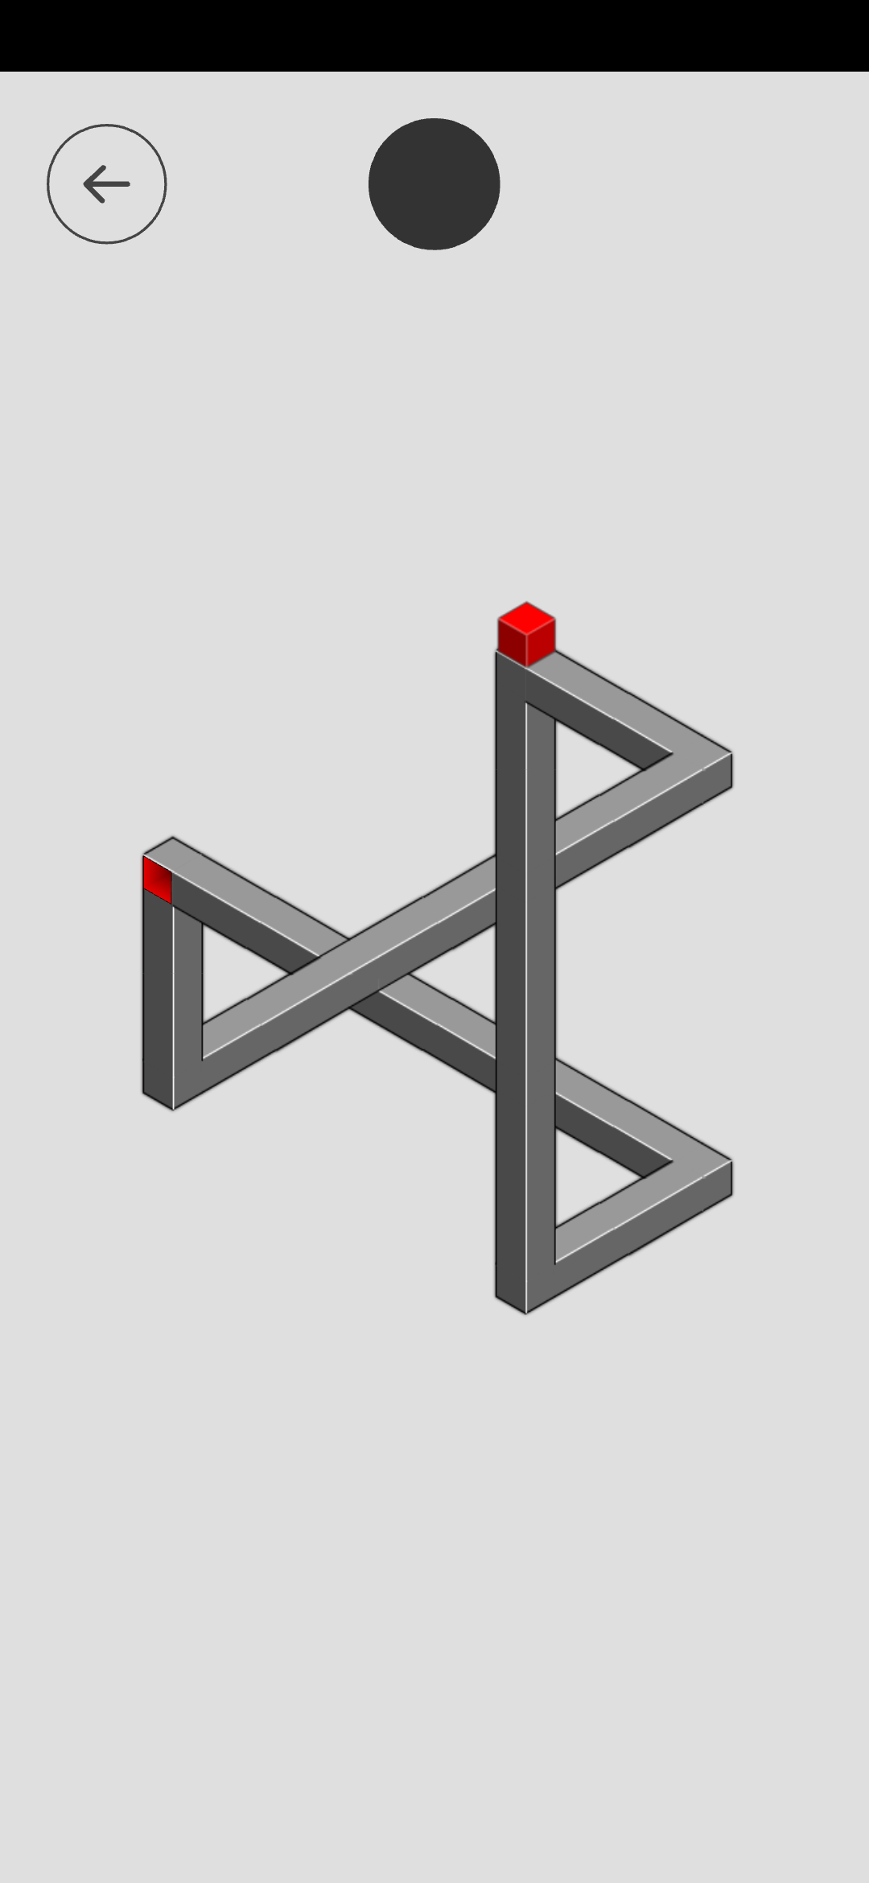
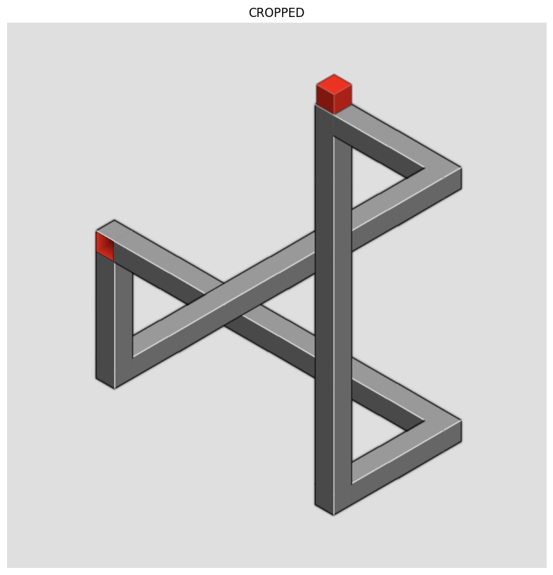
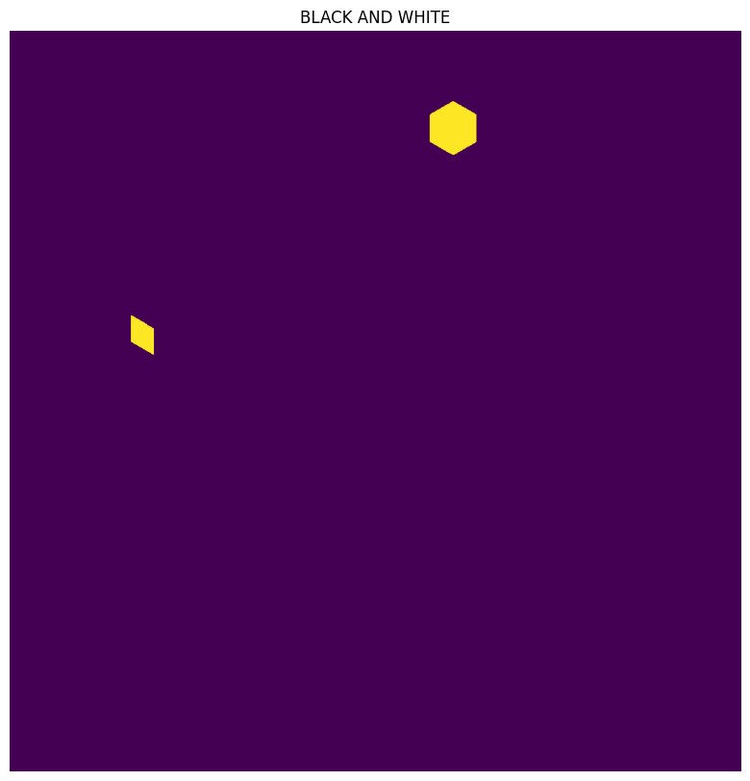
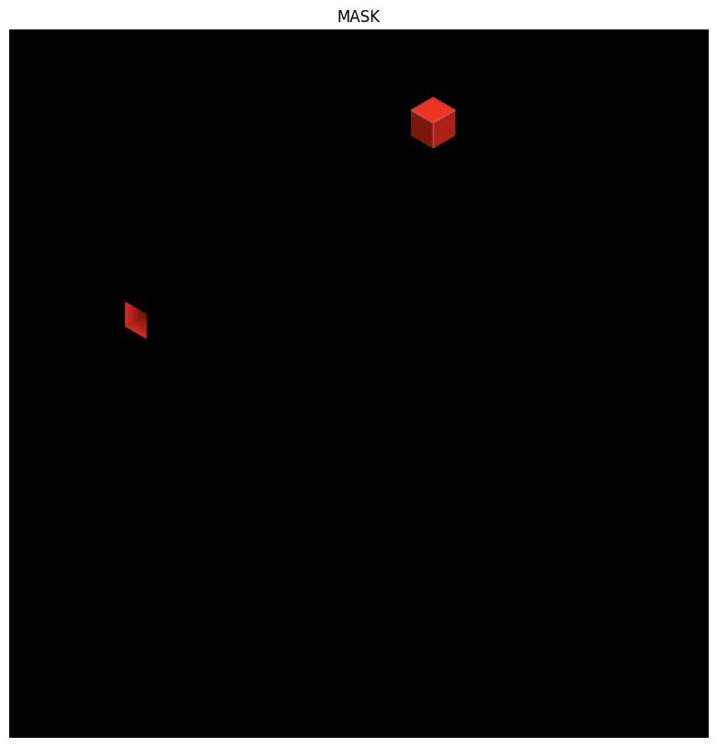
Hocus
Hocus Solver
ADB
The mobile device is connected to the Solver through ADB (Android Debug Bridge)
ADB fetches the screenshot of the maze upon the pressing of the space bar on the laptop
Methodology
1. SCREENSHOT
2. PROCESSING SCREENSHOT
The goal of this stage is the extraction of the following information:
The start node
The end node
Every hexagon’s links/connections to its neighboring hexagons
The “dash” link, which represents the link on top, in case of an overlap case
3. MODELING MAZE INTO CODE
4. EXPLORING MAZE
5. SOLVING MAZE
6. CONVERTING PATH TO SWIPES
7. PERFORMING SWIPES
Raw image
Cropped image
Black and white mask
Extracting mask

Slide 17
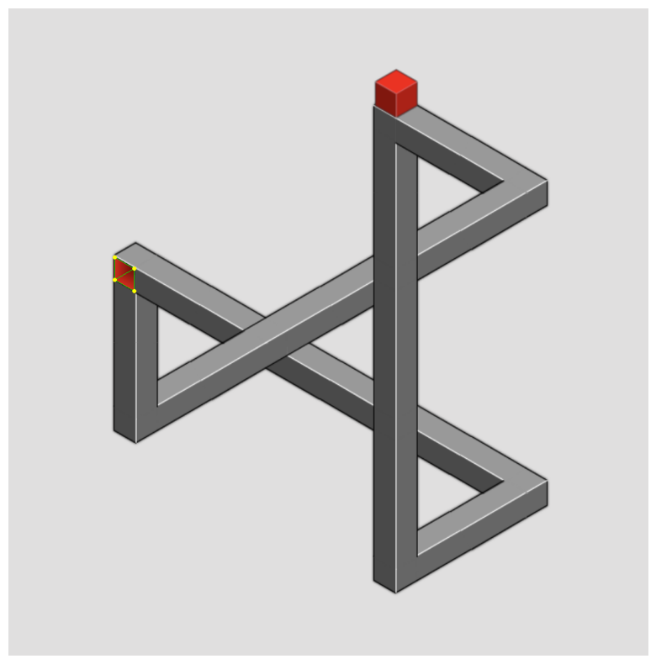

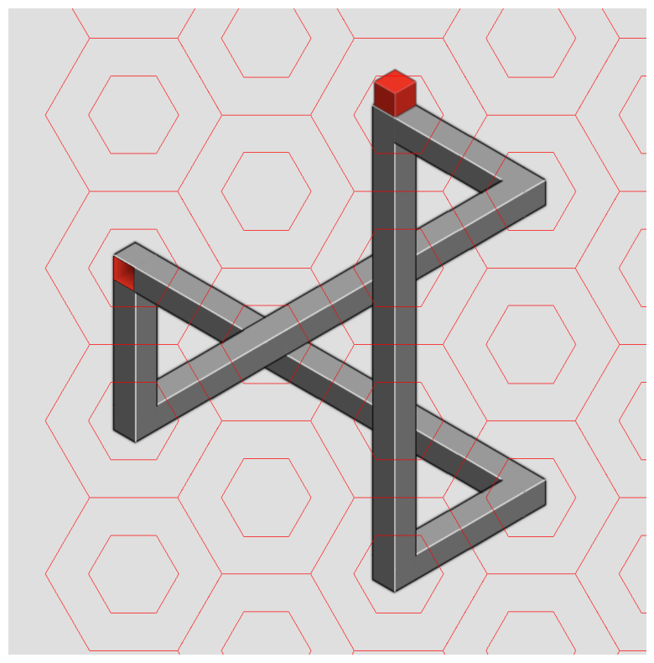
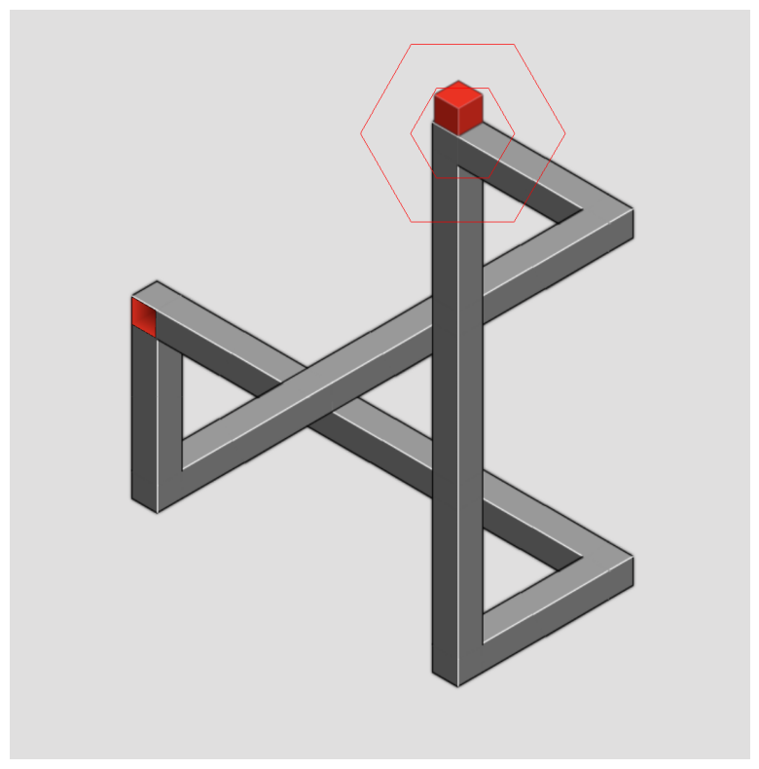
Methodology
The goal of this stage is the extraction of the following information:
The start node
The end node
Every hexagon’s links/connections to its neighboring hexagons
The “dash” link, which represents the link on top, in case of an overlap case
1. SCREENSHOT
2. PROCESSING SCREENSHOT
3. MODELING MAZE INTO CODE
Raw image
Cropped image
4. EXPLORING MAZE
5. SOLVING MAZE
6. CONVERTING PATH TO SWIPES
!
7. PERFORMING SWIPES
Black and white mask
Extracting mask
Contours
Goal Information
Plotting hexagon grid
Box information

Slide 18
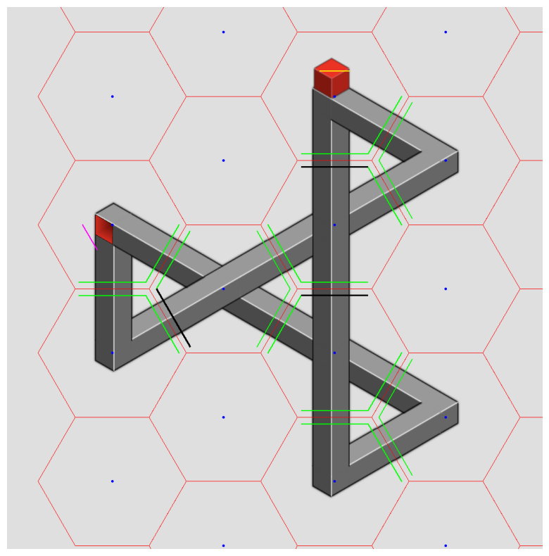
Methodology
Raw image
Cropped image
Black and white mask
Extracting mask
1. SCREENSHOT
2. PROCESSING SCREENSHOT
3. MODELING MAZE INTO CODE
Contours
Goal Information
4. EXPLORING MAZE
5. SOLVING MAZE
6. CONVERTING PATH TO SWIPES
7. PERFORMING SWIPES
Plotting hexagon grid
Box information
Connection and Overlap Extraction for all Hexagons
Final Evaluation

Slide 19
Methodology
Contours
Goal Information
Plotting hexagon grid
Box information
Connection and Overlap Extraction for all Hexagons
1. SCREENSHOT
2. PROCESSING SCREENSHOT
3. MODELING MAZE INTO CODE
4. EXPLORING MAZE
5. SOLVING MAZE
6. CONVERTING PATH TO SWIPES
7. PERFORMING SWIPES
Final Evaluation
Converting information obtained into object- oriented code for exploration

Slide 20
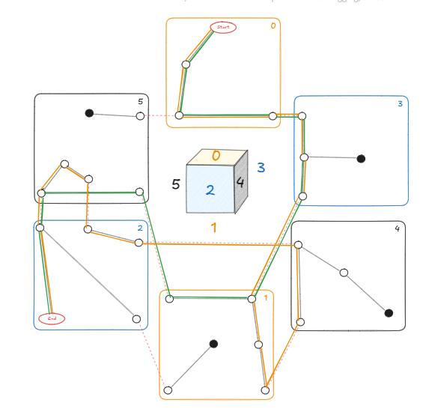
Methodology
Connection and Overlap Extraction for all Hexagons
Final Evaluation
1. SCREENSHOT
2. PROCESSING SCREENSHOT
3. MODELING MAZE INTO CODE
Converting information obtained into object- oriented code for exploration
4. EXPLORING MAZE
5. SOLVING MAZE
6. CONVERTING PATH TO SWIPES
7. PERFORMING SWIPES
Depth First Traversal of the information obtained through the hexagons to find all possible paths

Slide 21
Methodology
Converting information obtained into object- oriented code for exploration
1. SCREENSHOT
Depth First Traversal of the information obtained through the hexagons to find all possible paths
2. PROCESSING SCREENSHOT
3. MODELING MAZE INTO CODE
4. EXPLORING MAZE
5. SOLVING MAZE
6. CONVERTING PATH TO SWIPES
7. PERFORMING SWIPES
Applying Dijsktra to solve the obtained graph to find the shortest path from the box to the goal

Slide 22
Methodology
Depth First Traversal of the information obtained through the hexagons to find all possible paths
1. SCREENSHOT
2. PROCESSING SCREENSHOT
Applying Dijsktra to solve the obtained graph to find the shortest path from the box to the goal
3. MODELING MAZE INTO CODE
4. EXPLORING MAZE
5. SOLVING MAZE
6. CONVERTING PATH TO SWIPES
7. PERFORMING SWIPES
Converting the obtained path into swipes, by identifying the direction through connections between nodes.
Performing swipes through ADB

Slide 23
Methodology
Applying Dijsktra to solve the obtained graph to find the shortest path from the box to the goal
1. SCREENSHOT
2. PROCESSING SCREENSHOT
Converting the obtained path into swipes, by identifying the direction through connections between nodes.
Performing swipes through ADB
3. MODELING MAZE INTO CODE
4. EXPLORING MAZE
5. SOLVING MAZE
6. CONVERTING PATH TO SWIPES
7. PERFORMING SWIPES

Slide 24
05
Results
Converting the obtained path into swipes, by identifying the direction through connections between nodes.
Performing swipes through ADB

Slide 25
Results
Our solver passes through all levels present in the Hocus app
Our solver passes through any custom-made level, lest a valid path exists

Slide 26
Thank you!

